Slide 1
BANGALORE INSTITUTE OF TECHNOLOGY K.R.Road,V.V.Puram,Bangalore-560004 M.Tech ,Department of Computer Science & Engineering
TITEL:-
Seoul Bike Sharing Demand Prediction
Presented by Vidyasre.N 1BI22SCS07

Slide 2
Abstract
The "Seoul Bike Sharing Demand Prediction" project aims to develop a robust predictive model for forecasting bike rental demand in Seoul. Leveraging machine learning and statistical techniques, the project analyzes historical bike rental data, considering factors like weather, time, and events.
The anticipated outcome is an accurate prediction model that enhances the efficiency of bike-sharing programs. By optimizing resource allocation and improving user experience, the project contributes to sustainable urban mobility.
The methodology involves data preprocessing, feature engineering, and the application of regression or time series analysis, with a focus on incorporating external factors for better prediction accuracy.
The abstract underscores the project's significance in advancing eco-friendly transportation solutions and optimizing urban mobility management.

Slide 3
Introduction
Bike sharing is a popular and eco-friendly way for people to get around in Seoul.
Understanding when and where bikes will be in demand can greatly improve the efficiency of the bike-sharing system.
In this project, we're using machine learning to predict bike rental demand in Seoul.
By analyzing past data, like weather conditions, time of day, and holidays, we aim to create a smart model that can help city planners and bike-sharing providers better manage their resources.
The goal is to build a reliable prediction tool that can anticipate when and where bikes will be needed the most.

Slide 4
Objectives
The primary objective is to develop an accurate and reliable machine learning model for predicting hourly rental bike demand in urban settings, facilitating optimal resource planning and ensuring a stable and accessible supply of bikes. This project seeks to empower city planners and bike-sharing providers with actionable insights to enhance the efficiency and user experience of bike-sharing systems.
Data Loading and Cleaning
Exploratory Data Analysis EDA
Data Preprocessing:
Feature Engineering
Model Development
Model Evaluation
Optimization
Incorporating External Data

Slide 5
Dataset description
The dataset contains weather information (Temperature, Humidity, Wind speed, Visibility, Dew point, Solar radiation, Snowfall, Rainfall), the number of bikes rented per hour and date information.
Attribute Information:
Date : year-month-day
Rented Bike count - Count of bikes rented at each hour
Hour - Hour of he day
Temperature-Temperature in Celsius
Humidity - %
Wind speed - m/s
Visibility - 10m
Dew point temperature - Celsius

Slide 6
Cont…
Solar radiation - MJ/m2
Rainfall - mm
Snowfall - cm
Seasons - Winter, Spring, Summer, Autumn
Holiday - Holiday/No holiday
Functional Day – No
Func(Non Functional Hours), Fun(Functional hours)

Slide 7
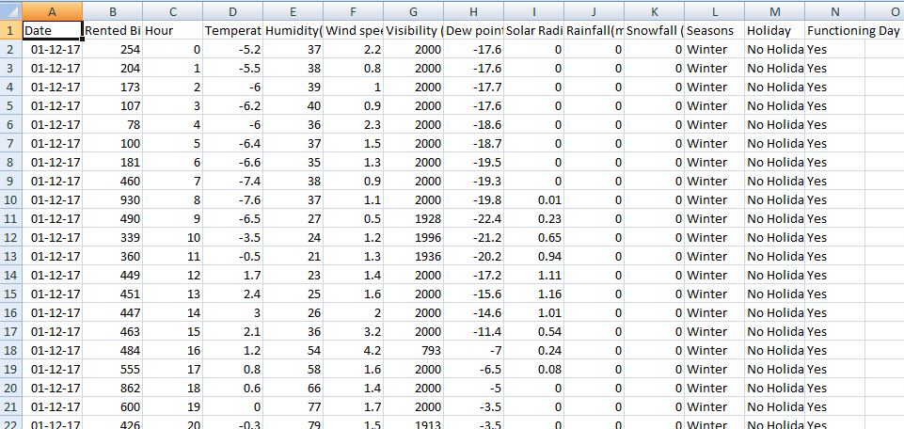
Snapshot of dataset
Fig1: Dataset snapshot

Slide 8
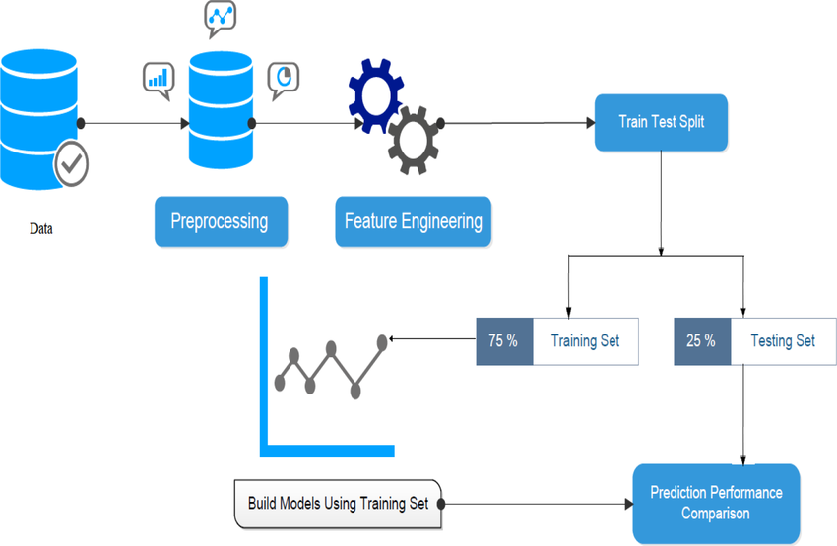
Work flow model

Slide 9
Tools used
Python Programming Language: The entire code is written in Python.
Pandas: Used for data manipulation and analysis. It provides data structures like Data Frame for efficient handling of structured data.
NumPy: Used for numerical operations and array handling. It provides support for large, multi-dimensional arrays and matrices.
Matplotlib: A 2D plotting library used for creating static, animated, and interactive visualizations in Python.
Seaborn: A statistical data visualization library based on Matplotlib. It provides a high-level interface for drawing attractive and informative statistical graphics.
Scikit-learn (sklearn): A machine learning library for various tools for data mining and data analysis. In this code, it is used for preprocessing, model selection, and evaluation.

Slide 10
Cont…
GridSearchCV and RandomizedSearchCV: Methods from Scikit-learn used for hyperparameter tuning through grid search and randomized search.

Slide 11
ML Techniques used
Linear Regression:
Simple and interpretable; suitable for linear relationships between features and the target variable.
Lasso Regression: Applies L1 regularization, leading to feature selection by driving some coefficients to zero.
Ridge Regression: Incorporates L2 regularization, preventing over fitting by penalizing large coefficients.
Gradient Boosting Algorithms (e.g., XG Boost)
Build a strong predictive model by combining weak models sequentially; often performs well in various scenarios.
Random Forest:
Ensemble technique using multiple decision trees; robust and handles complex relationships well.

Slide 12
Methodology
The methodology for the "Seoul Bike Sharing Demand Prediction" project involves several key steps in building and deploying a machine learning model.
Clearly define the problem of predicting bike-sharing demand in Seoul.
Specify the target variable, features, and evaluation metrics.
Identify and gather relevant data sources, including historical bike-sharing records, weather data, and any additional factors influencing demand.
Handle missing values, outliers, and inconsistencies in the collected data.
Perform data cleaning and transformation to prepare the dataset for analysis.
Conduct EDA to gain insights into the data distribution, correlations, and patterns.
Visualize key features and relationships between variables.
Create new features or transform existing ones based on insights from EDA.

Slide 13
Cont..
Enhance the dataset with relevant information that may impact bike-sharing demand.
Choose appropriate machine learning algorithms for regression or time series forecasting.
Split the dataset into training and testing sets for model evaluation.
Train the selected machine learning model using the training dataset.
Optimize hyper parameters to improve model performance.
Evaluate the model's performance using metrics like Mean Squared Error (MSE) or Root Mean Squared Error (RMSE).
Validate the model on the testing dataset to assess its generalization capability.
Fine-tune the model based on performance evaluations.
Address over fitting or under fitting issues and improve the model's accuracy.

Slide 14
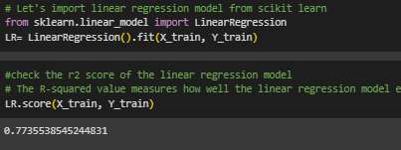
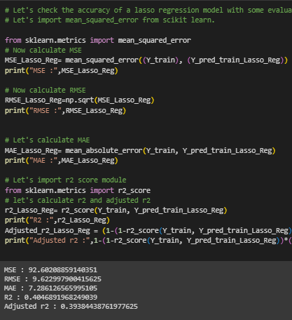
Result
Fig: Linear Regression
Fig:Lasso Regression

Slide 15
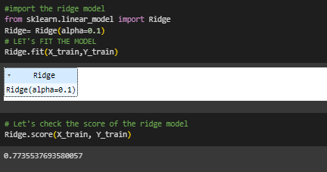
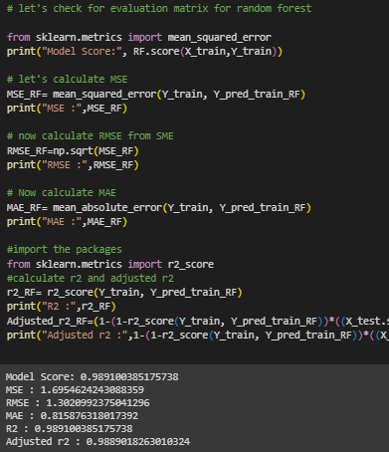
Fig: Ridge Regression
Fig:Random Forest Regression

Slide 16
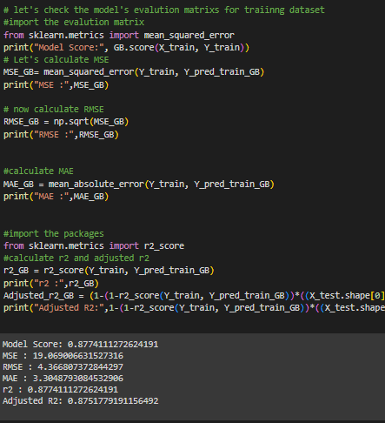
Fig: Gradient Boosting Regression

Slide 17
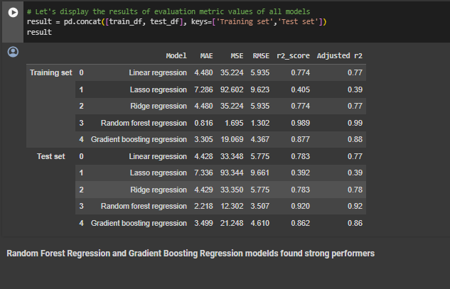
Fig:Random Forest Regression and Gradient Boosting Regression modelds found strong performers

Slide 18
Conclusion
In assessing regression models for bike-sharing demand prediction, Linear, Lasso, and Ridge regressions showed varying results. While Linear and Ridge were comparable, Lasso lagged. Notably, Random Forest and Gradient Boosting excelled, outperforming others with lower errors. Ensemble methods, particularly Random Forest and Gradient Boosting, proved superior for Seoul's bike-sharing demand prediction.

Slide 19
Thank you

